Slide 1
VSC HPC Introduction
ICTS KU Leuven VSC staff: Ehsan Moravveji Mag Selwa Wouter van Assche Geert Jan Bex (Uhasselt) Jan Ooghe

Slide 2

Material
Everything is on Github: https://hpcleuven.github.io/HPC-intro/
Video Recordings - Scan the QR code - Recommended videos: ~ 2 hrs - Optional videos: ~1 hr
By registering and participating in VSC trainings, you conform to the VSC trainings code of conduct.
2

Slide 3

What is High Performance Computing?
Using supercomputers to solve advanced computation problems
Reduce the computation time from days, years, decades, or centuries to minutes, hours, days, or weeks
The key is parallelism
Access to specialized hardware (GPU, large memory, high-speed interconnect)
Notes:
HPC is about techniques of boosting the efficiency of your codes and computation to enhance the compute performance as compared with a similar workflow on a typical laptop or workstation.

Slide 4

In practice, it is more like …
The concept is simple: Parallelism = employing multiple processors for a single problem
Notes:
In practice, there is a pool of computing resources made available to you which are waiting to receive instructions from the user. The nodes are all inter-connected, which means you can employ more than one node in a specific compute task, and the nodes within the task can communicate with one another at runtime, whenever needed.

Slide 5
Outline
Part 1: Basics
Part 2: Hands-on
VSC
Tier-2 Clusters
Storage
Accounting
Login Open OnDemand SSH client & Terminal NX
Data Transfer FileZilla rsync Globus
Using Open OnDemand
Software
Miniconda
Batch Jobs
Worker
Demo: test yourself
5

Slide 6

VSC (Vlaams Supercomputer Centrum)

Slide 7




















VSC PARTNERSHIP
A n t w e r p e n
O o s t
V l a a n d e r e n
Supported by
W e s t
V l a a n d e r e n
L i m b u r g
V l a a m s - B r a b a n t
B r u s s e l
vscentrum.be
7
Notes:
VSC is a partnership between 5 major universities and associations in Flanders, namely … and is spread among 4 sites. VSC is sponsored by the flemish research organization FWO. The idea is that the academics (scientists, students) and industrial partners in Flanders have an easy access to compute and storage facilities. Hence any individual with a single VSC account is eligible to compute on any cluster/site that he/she deires

Slide 8

Surf to: www.vscentrum.be
Very rich suite of courses every academic year
Documentation! Answers >80% of your questions and access to account page

Slide 9

9

Slide 10
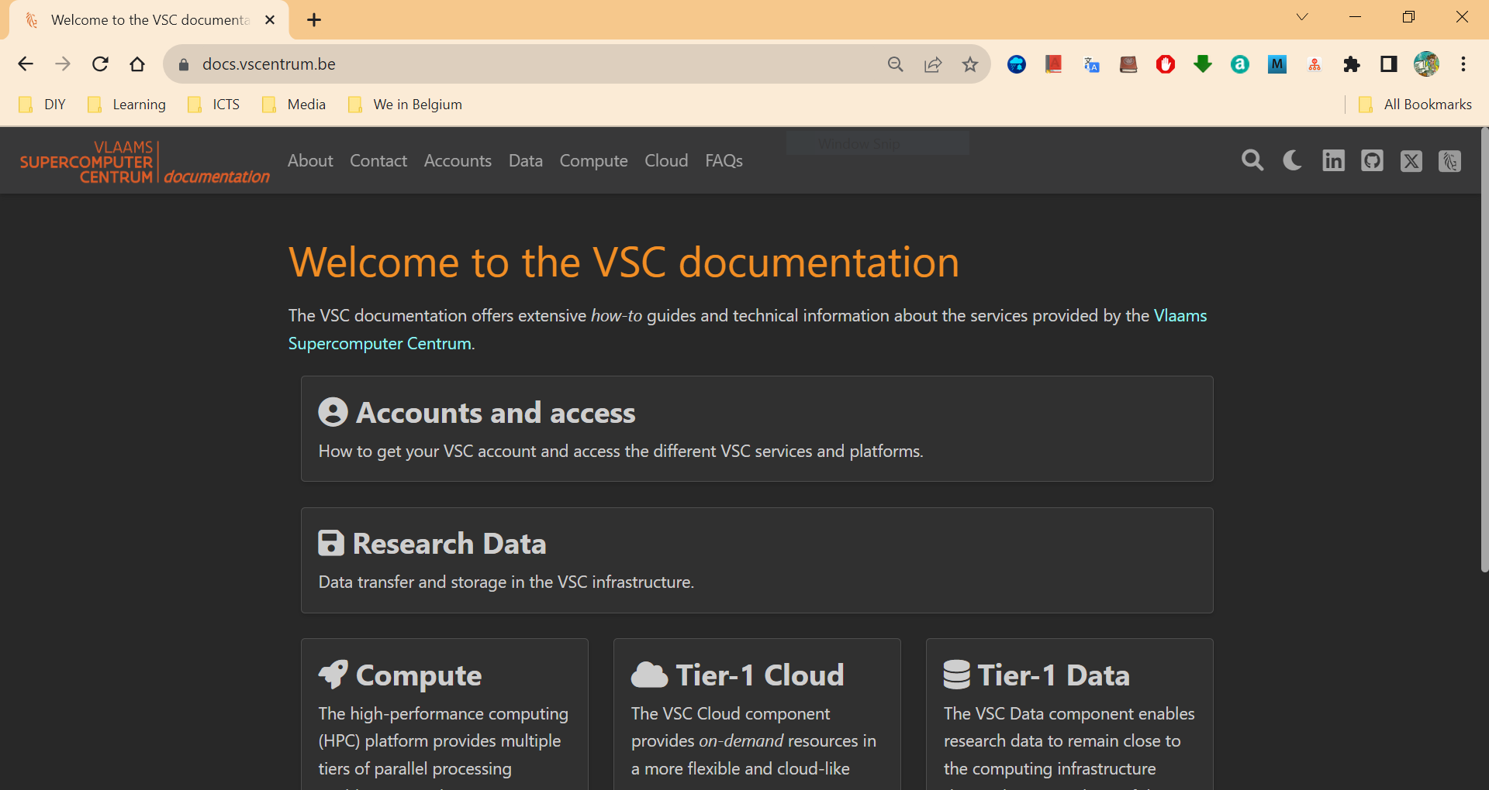
https://docs.vscentrum.be
Search your keywords here; e.g. SSH key
Notes:
All items are indexed
There is a power search engine there.
Just put a keyword there.

Slide 11
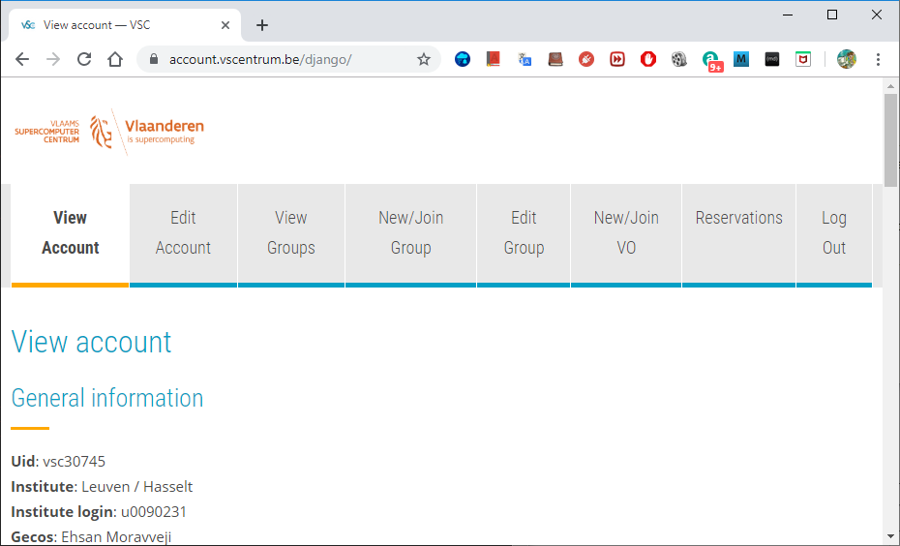
To manage your VSC account: account.vscentrum.be
Upload more SSH public keys
Upload SSH Key Request account
Create or request to join a new group
Moderate your own groups (add/remove users)

Slide 12
Support and Services
Basic support
Helpdesk (hpcinfo@kuleuven.be)
Monitoring and reporting
Application support
Installation and porting
Optimisation and debugging
Benchmarking
Workflows and best practices
Training
Documentation and tutorials
Scheduled trainings / workshops
On request workshops
One-to-one sessions

Slide 13
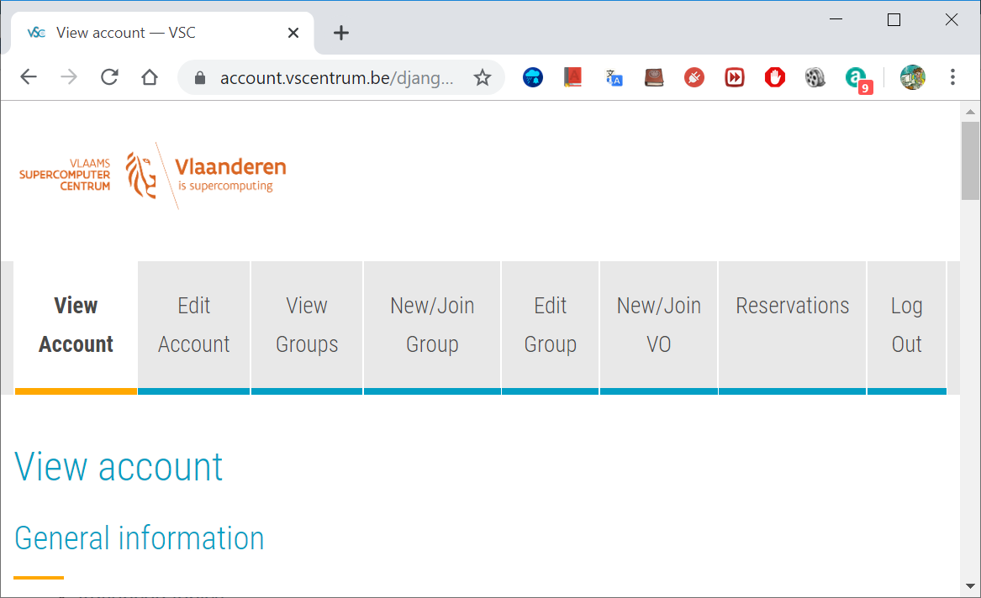

Become a VSC user
(Optional) Create a secure (4096 bit) SSH key pairs Upload it on the account page: www.account.vscentrum.be
You need to request a VSC account Normally processed swiftly
Request introductory credits (2M free credits for 6 months)
Request project credits (for supervisors and project leaders) You need to create a VSC group Add users to the group to give them access to use credits Fill out the request form
Extra storage requests Scratch extension: free of charge Staging fileset: 20 € per TB per year
All service costs (compute and storage) are all explained Go to ICTS service catalogus: https://icts.kuleuven.be/sc Click on High Performance Computing (NL/EN)
13

Slide 14
Infosessions:
Containers
Notebooks
VSC training
Matlab (Supercalculator)
Matlab Programming
Linux for HPC
Linux scripting
Introductory
Intermediate
Advanced
Specialized track
Make intro
Linux tools
Linux
HPC intro
CMake intro
Version control systems
C
Python as a second language
Python: System programming
Scientific Python
Python for Software engineering
Python for data science
Python for machine learning
worker/atools
C++ for scientific computing
Julia good bad ugly
Fortran for programmers
High Performance Python
Debugging techniques
OpenMP
?
MPI
Code optimization
Stay up-to-date https://www.vscentrum.be/en/education-and-trainings

Slide 15
To Acknowledge VSC in publications
Why?
At KU Leuven
a contractual obligation for the VSC
helps VSC secure funding
you will benefit from it in the long run
add the relevant papers to the virtual collection "High Performance Computing" in Lirias
In het nederlands
In English
De rekeninfrastructuur en dienstverlening gebruikt in dit werk, werd voorzien door het VSC (Vlaams Supercomputer Centrum), gefinancierd door het FWO en de Vlaamse regering – departement EWI.
The computational resources and services used in this work were provided by the VSC (Flemish Supercomputer Center), funded by the Research Foundation - Flanders (FWO) and the Flemish Government – department EWI.

Slide 16
Tier-2 Clusters

Slide 17







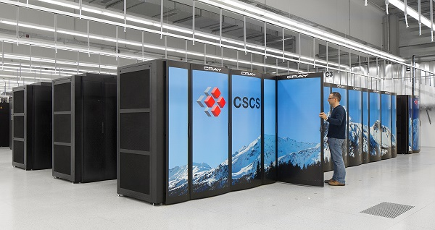








VSC HPC Environments
Tier-0
Tier-1
Hortense
Tier-2
STEVIN | HYDRA | HOPPER/LEIBNIZ | GENIUS/WICE
17
Notes:
All VSC users can use Tier-2 clusters from any site they desire.
If you still require more compute resources which does not fit into available Tier-2 limits, you can apply for Tier-1 compute time.
Even if Tier-1 level is insufficient, you can apply for Tier-0 level where Belgium is also part of a European consortium.

Slide 18


Tier-2 Clusters @ KU Leuven
Genius (since 2018) 250 nodes: 8,936 cores
wICE (since 9/2022) 186 nodes; 13,392 cores
18

Slide 19
Tier-2 Cluster - Genius
Node type | CPU type | # cores | Total mem | Mem per core (MB) | Partition
Cascadelake | Xeon Gold 6240 | 36 | 192 GB | 5000 | batch
Skylake large mem | Xeon Gold 6240 | 36 | 768 GB | 21000 | bigmem
Skylake GPU | Xeon Gold 6140 4xP100 SXM2 16GB | 36 | 192 GB | 5000 | gpu_p100
Cascadelake GPU | Xeon Gold 6240 8xV100 SXM2 32GB | 36 | 768 GB | 21000 | gpu_v100
Superdome | Xeon Gold 6132 8 sockets | 112 | 6 TB | 53500 | superdome
End of life: end 2024
Access: login.hpc.kuleuven.be
Interconnect: InfiniBand EDR (25 Gb/s)
SSD Disks: 200 GB
Remarks

Slide 20
Tier-2 Cluster - wICE
Node type | CPU type | # cores | Total mem | Mem per core (MB) | Partition
Icelake | Xeon 8360Y | 72 | 256 GB | 3455 | batch_icelake
Sapphire Rapids | Xeon 8468 | 96 | 256 GB | 2500 | batch_sapphirerapids
Icelake large mem | Xeon 8360Y | 72 | 2 TB | 28000 | bigmem
Icelake large mem | Xeon 8360Y | 72 | 8 TB | 111900 | hugemem
Icelake GPU | Xeon 8360Y 4xA100 SXM2 80GB | 72 | 512 GB | 7000 | gpu_a100
AMD GPU | Epyc 9334 4xH100 SXM5 80GB | 64 | 768 GB | 11700 | gpu_h100
Icelake Interactive | Xeon 8358 1xA100 SXM2 80GB | 64 | 512 GB | 7500 | interactive
Phase 1: since September 2022
Access: login.hpc.kuleuven.be
Interconnect: InfiniBand HDR (100 Gb/s)
SSD Disks: 960 GB
Interactive partition: max resources: 8 cores, 1 GPU, 16hr
Remarks

Slide 21

Tier-2 Cluster - wICE
Compute nodes
Large memory nodes
GPU nodes
5x IceLake 72c 2048 GB
4x IceLake 72c 512 GB
4 A100 SXM4 80GB
Interactive nodes
No Dedicated Login Nodes
172x IceLake 72c 256 GB
4x IceLake 64c 512 GB
1 A100 80GB
21

Slide 22
Tier-2 Cluster – wICE extension
Compute nodes
Large memory nodes
GPU nodes
1x IceLake 72c 8 TB
4x AMD Genoa 64c 768 GB
4x H100 SXM5 80GB
68x Sapphire Rapids 96c 256 GB
22

Slide 23
Storage

Slide 24

Overview of the storage infrastructure
Only you own your files (POSIX) Users can share folders via VSC groups
A VSC account has 3 default storages (free of charge)
$VSC_HOME
$VSC_DATA
$VSC_SCRATCH
You can additionally request staging storage
Different storage volumes have different:
mount point
size and performance
use case
backup and maintenance policy
More info on ICTS Service Catalog (EN/NL)

Slide 25
Storage
Example
Do NOT use /tmp It is only 10 GB and is reserved for the OS and root processes. Your application can crash if using /tmp
You are automatically logged into your home folder upon login. Immediately go to your other storages, e.g. $ cd $VSC_DATA
Always check your storage balance using myquota command
$ myquota
file system $VSC_HOME
Blocks: 1479M of 3072M
Files: 12934 of 100k
file system $VSC_DATA
Blocks: 12G of 75G
Files: 1043k of 10000k
file system $VSC_SCRATCH
Blocks: 15M of 1.5T
Request form for extra storage
More information
25

Slide 26
Storage | home folder
Env. Variable | $VSC_HOME
Filesystem Type | NFS
Access | Global
Backup | Hourly, daily, weekly (until last month) inside the .snapshot folder.
Default Quota | 3 GB
Extension | Not possible
Usage | Only storing SSH keys, config files
Remarks | - Stay away from using it - Can easily overflow: + Your jobs may crash + Login issues
Storage
home
data
scratch
node scratch
staging
Tier1 data
26

Slide 27
Storage | data folder
Env. Variable | $VSC_DATA
Filesystem Type | NFS
Access | Global
Backup | Hourly, daily, weekly (until last month) inside the .snapshot folder.
Default Quota | 75 GB
Extension | On purchase
Usage | Your data, code, software, results
Remarks | Permanent storage for initial/final results Not optimal for intensive or parallel I/O
Storage
home
data
scratch
node scratch
staging
Tier1 data
27

Slide 28
Storage | scratch folder
Env. Variable | $VSC_SCRATCH
Filesystem Type | Lustre
Access | Local
Backup | delete after 30 days from last access
Default Quota | 500 GB
Extension | Free
Usage | Intensive, parallel I/O, temporary files
Remarks | Recommended storage for all jobs Copy scratch files to VSC_DATA or local storage after jobs are done Deleted files cannot be recovered
Storage
home
data
scratch
node scratch
staging
Tier1 data
28

Slide 29
Storage | Node scratch folder
Env. Variable | $VSC_SCRATCH_NODE
Filesystem Type | Lustre
Access | On compute node, only at runtime
Backup | None
Default Quota | 591 GB
Extension | Read about beeOND
Usage | Temporary storage at runtime
Remarks | Fastest I/O, attached to the node Is cleaned after job terminates Copy the data to your home, scratch, or staging before job ends
Storage
home
data
scratch
node scratch
staging
Tier1 data
29

Slide 30
Storage | Staging folder
Path | /staging/leuven/stg_000XX
Filesystem Type | Lustre
Access | On demand, only Tier-2@KUL
Backup | None
Default Quota | None
Extension | On purchase, from 1 TB
Usage | Permanent; share with a group
Remarks | Accessible from login/compute nodes Fast, parallel I/O
Storage
home
data
scratch
node scratch
staging
Tier1 data
30

Slide 31
Storage
VSC offers Tier-1 Data as a large storage service
Only for active data (no archiving)
Supports metadata (search & discover)
Share within VSC (permission management)
Share outside VSC (via Globus)
Stage-in/stage-out data workflow
Free of charge (for academia)
Starting volume is 1 PB
Access is based on proposal Apply anytime
Tier1 data
staging
scratch
data
home
node scratch
31

Slide 32
Tier-2 credit system - what
What is a credit
Credits are a measure for compute time
Shared nodes are charged based on used fraction
Cluster / Partition | Credits/h
Genius Skylake / Cascadelake / AMD | 10 000
Genius Skylake BigMem | 12 000
Genius Skylake 4 GPUs | 20 000
Genius Cascadelake 8 GPUs | 39 900
Genius Superdome | 126 000
wICE Icelake thin node | 11 000
wICE Icelake Large Memory | 19 000
wICE IceLake GPU node | 45 000
wICE interactive node | /
Check ICTS service catalogue : https://icts.kuleuven.be/sc/english/research/HPC
Notes:
What is a credit? A credit is nothing more than a measure for an amount of compute time. How we came to the current credit ratio is a long history, which is not really relevant.
The list below shows the current types of nodes in our Tier-2 environment and there credit usage ratio. Please consult the service catalogue for up to date available systems, their credit rates and the credit cost.
From the table you can see that a GPU node is a lot more expensive. But these also includes the four or eight GPUs in the machine. Which are actually very expensive, so it's reasonable that these nodes consume a lot more credits. As Superdome has 6TB of RAM with 144 cores, you can understand that this is our most expensive node at the moment.
Slurm allows us to configure the different type of resources that should be accounted. We have focused it on usage of CPU cores and GPU devices. each resource will use a number of credits for a given time. The table shows the credits usage of a full node (all available cores/GPU’s) when using it for one hour.
Why are the ratios so high, yu might ask? When we started using Slurm, the credits/hour ratio was multiplied with a factor 1000 to assure that Slurm internals is billing the credits with enough accuracy. But no worries you are also getting 1000 times more credits for your money.
Note that nodes can be used in a shared mode, When submitting a job with only one GPU and a quarter of the cores, it will be only charged for using one single GPU. The same goes for the CPU nodes, you will be only charged for the CPUs that are used. But mind that in case you are using more than defualt RAM memory per core, also the additional cores will be charged. In the extrem case if you would use a single core and the whole node memory, you will be charged for the full node.

Slide 33
Tier-2 credit system - why
Why are credits used
Used to manage access the computational resource
Tracebility, accountability
Why are credits charged
Small fraction
Optimizing your code/workflow will result in spending less credits
Notes:
So why do we use the credit system?
Firstly, it is a tool to manage the access to our computational resources. And secondly it provides additional benefits like traceability and accountability. If you have for instance master students and you want to grant them computational access on a project, you can create a separate project for them and put some credits on it. You're in complete control of who get’s access and what the maximum amount of resources is that they will be able to use. You can even follow up on what they've been using.
The same goes for European projects or other type of projects where you need to have a trace for a possible audit This can be delivered with the traces of the credit system.
And why are we charging a cost for the usage?
First of all know that we are only charging a very small percentage of the actual cost price of this machine. By charging awareness is raised that the supercomputer is a research infrastructure that is very expensive. So you should try to use it as efficiently as possible, just as you would do when you are using some type of expensive microscope or if you are raising some guinea pigs, when using expensive chemicals, ... . All those things cost money, also computational power does actuall cost money.
By charging for the credits, if someone puts in the effort to optimize code or workflows, is been rewarded by spending less money on it.
You should know that the cost of the compute time is only about 5% of the real cost.

Slide 34
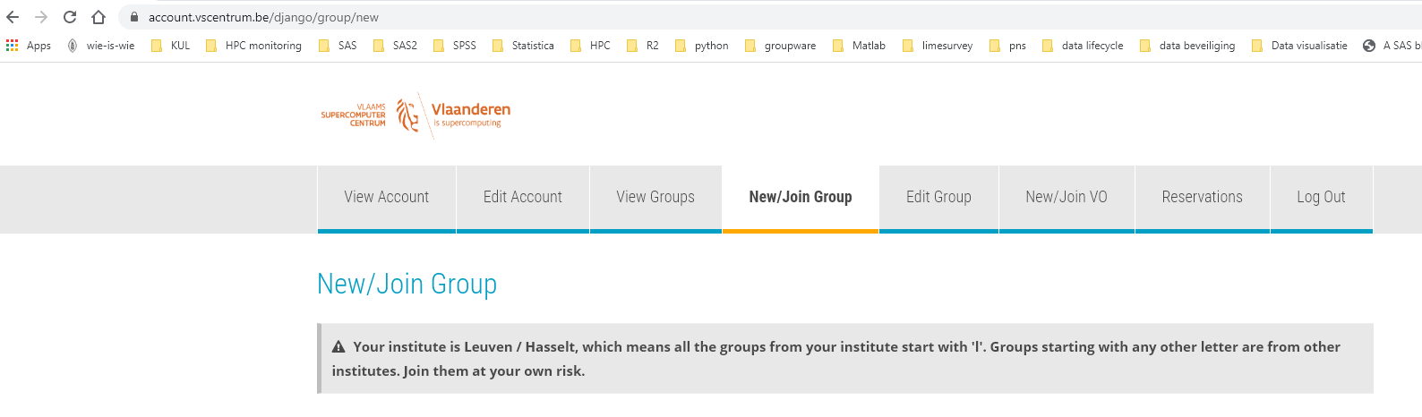
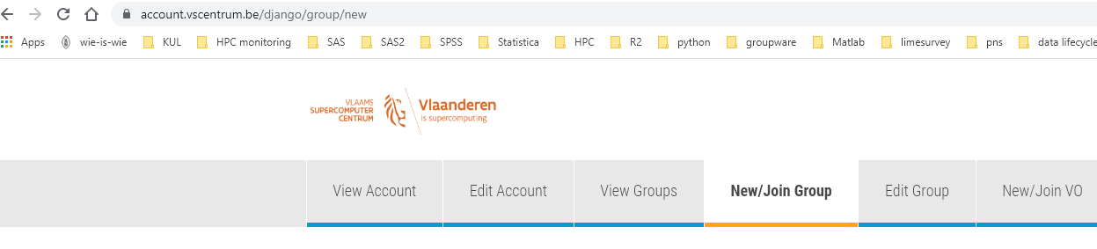
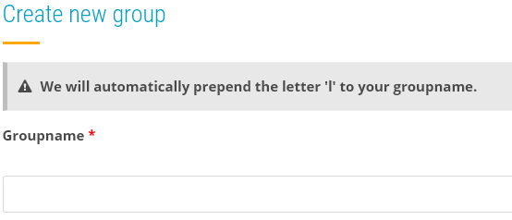
Tier-2 credit system – how to get credits
Check ICTS service catalogue : https://icts.kuleuven.be/sc/english/research/HPC
Request your introduction credits
Everybody
Free of charge
1 time
6 months
Request permission to join a group
Request project credits
Create group on the accountpage
Start the name preferably with p_
Your group will be lp_
Who creates the group can add or remove users
Tier-2 credits are shared over all Tier-2 system
Notes:
How do you get your hands on some compute credits?
Well first of all each user can request introduction credits. It is a one time thing, you get 2 million credits free of charge.
As the name indicates, it is meant to to give you some time to get acquainted with the Tier-2 cluster.
Check the service catalog for the procedure to follow to request these introduction credits.
If you will be joining a research group that already is computing on the cluster then probably they already have a project with compute credits.
In that case just ask your fellow researchers the name of this project.
Then go to the account page, do a join request,
select the join group option,
type in the name of the of the project and
then send a request to be added to the group.
The moderator will see this group and can accept or reject. Once accepted you will be able to use the credits that are linked to this project group.
If you're starting, you have your own research group and you want to request project credits for yourself it's also possible.
The procedure is in the service catalog but know that you best
first create a new group,
give it a name that makes sense to for you and start the name with P underscore. This will make it clear that is is a project meant for project credits.
the system will automatically prefix your name with an L because it's a group created in Leuven.
Groups created by users in Ghent will have a G as a prefix and groups from Antwerp will have an A as a prefix.
When you create a group you will be moderator of the group and you can decide who to invite, accept or remove from your group.
You're in complete control of who has access to the compute credits that are bound to this group.
By default the credits are available on all Tier-2 systems.

Slide 35
Tier-2 credit system - how
Submit your jobs with reference to the correct project
#SBATCH –A lp_myproject
sbatch … -A lp_myproject
Before submitting the job, the amount of available credits is checked with the maximum requested credits for the job
Maximum charge for the submitted jobs is calculated
Credits = minutes * floor(#cpu cores*billing_weight_CPU + #gres*billing_weight_gres)
Taking into account any running jobs
When the job finishes, the actual cost is charged
Notes:
So once you have access to the compute credits how do you use them?
Well this has already been shown in the videos before.
You need to specify your project on the SBATCH directive with a minus A option and then the name of your project.
You can do this both in a Slurm script as on the SBATCH command line.
How does charging actually works?
First of all when you submit your job the maximum amount of credits that your job can cost will be computed. This is based on the number of CPU cores that you request, the number of requested GPUs , The type of the cpu and the requested wall time.
This gives the maximum amount of credits that will be used for this job.
Before the jobs get submittted, the system will check if there are enough credits available. This will take into account the current balance and the number of credits that are needed for any job that is currently running.
When the job is finished only the actual cost will be charged. So if you request three days wall time but your job is finished after one day you only will be charged for this one day of computation.
With the sam-quote tool you can get a calculation of the credit cost, based on the specified parameters.

Slide 36
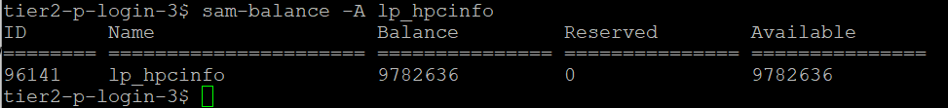
Tier-2 credit system – manage your credits
Slurm Accounting Manager => sam- commands
Command | Purpose
sam-balance [-A account] | List active projects and available credits
Notes:
There are a number of commands that you can use to manage your credits.
One thing all the commands have in common that is that they start with sam-
It is the abbreviation for "Slurm Accounting Manager" . These scripts wrapp standard slurm commands, but give you an easy to read output.
The first one is sam-balance. It will give you an overview of all your active projects and their status. With the optional minus A you can query a specific account .
In the overview The reserved column are credits of jobs that are still running and not yet have substracted from the account. The available column shows the effective amount of credits available to submit new jobs.

Slide 37
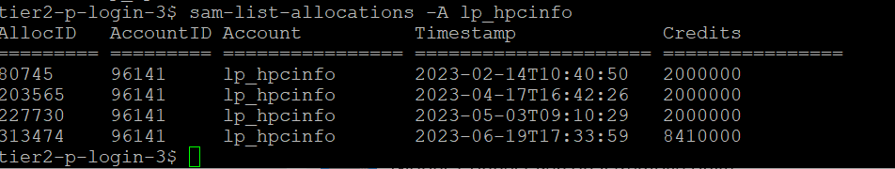
Tier-2 credit system – manage your credits
Slurm Accounting Manager => sam- commands
Command | Purpose
sam-list-allocations –A <account-name> | List the validity dates of different projects/allocations
Notes:
Another command which is very useful is the sam-list allocations, followed with minus A and the account name. The different deposits in this project will be shown, in this account and they all had a different deposit date.

Slide 38
Tier-2 credit system – manage your credits
Slurm Accounting Manager => sam- commands
Command | Purpose
sam-quote sbatch [sbatch arguments] [my_job.slurm] | Shows the amout of credits a job will use
Notes:
Sam-quota will give you an estimated of the amount of credits you need to run the job. You can run it by supplying a batch script or by adding specific SBATCH directives on the command line.

Slide 39
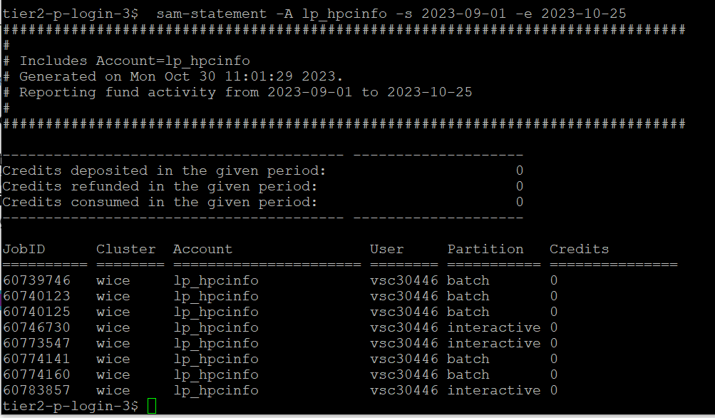
Tier-2 credit system – manage your credits
Slurm Accounting Manager => sam- commands
Command | Purpose
sam-statement -A <account-name> -s <start-date> -e <end-date> | Overview of credits used on each job in a specific time window
Notes:
Sam-Statement will give you an overview off all jobs that you submitten in a specific time period. You will only see your own jobs, unless you have elevated rights on the project account.

Slide 40
Tier-2 credit system – manage your credits
Slurm Accounting Manager => sam- commands
Command | Purpose
sam-balance | List active projects and available credits
sam-list-allocations –A <account-name> | List the validity dates of different projects/allocations
sam-quote sbatch [sbatch arguments] [my_job.slurm] | Shows the amount of credits a job will use
sam-statement -A <account-name> -s <start-date> -e <end-date> | Overview of credits used on each job in a specific time window
Notes:
To summarize this is an overview of the different sam commands that are really useful for you so
sam-balance to get an overview of the balance.
sam-list allocations to have an overview of different deposits
Sam-quote to get an estimation for the amut of credits that you need to run a job
Sas-statement to giveyou a detailed overview of jobs that have run in a specific time window.
This completes the basic information about the credit system. There are other things to tell but this is outside the scope of th eintroduction. If you have specific questions just don't hesitate to ask them in the follow-up online session or just send them to your service desk email address.

Slide 41
Login Nodes & MFA

Slide 42

Accessing a Cluster
Compute nodes
Firewall
Infiniband interconnect
Link to other VSC sites
Scientist
MFA or SSH Authentication
Administration - queue system, job scheduler, user management,…
Login nodes
Service nodes
Storage
42

Slide 43
How to login?
Open OnDemand
SSH client
Web-based login via browser
https://ondemand.hpc.kuleuven.be
Multi-Factor Authentication (MFA): Login first to your institute/university
No SSH-key needed
Windows: PuTTY, MobaXterm, NoMachine MacOS/Linux: terminal, NoMachine
Requires (open)SSH keys
Upload your key to VSC account page wait at least 30 minutes
Hosts: login.hpc.kuleuven.be:22 nx.hpc.kuleuven.be (NX)
Use SSH agent (recommended) Use SSH Config (recommended)
Can open GUIs if X11 is configured
NX
Graphical desktop
Using NoMachine client
Using GUI (Matlab, SAS, visualization)
Nvidia Quatro GPU for visualization
43

Slide 44
Using Login Nodes
To develop code
To check your storage and credit balance
To manage jobs (submit, check status, debug, resubmit, …)
To move data around
within VSC: use data, scratch, staging
outside VSC: copy/sync from/to your local storage (e.g. Globus)
To pre-/post-process your data/jobs
To visualize your data
To share files/folders
Tips
Warning
Do NOT execute heavy-lifting tasks (core, memory)
Login nodes are shared resources
Instead, submit jobs: e.g. Compile your software on compute nodes. Check $ slurmtop to see how busy the cluster is
44

Slide 45
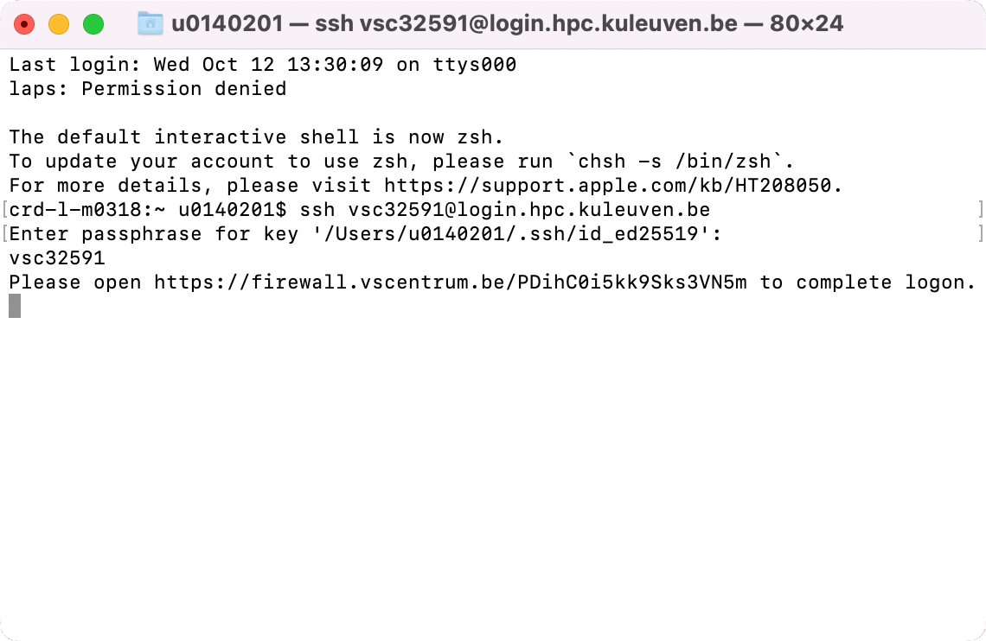
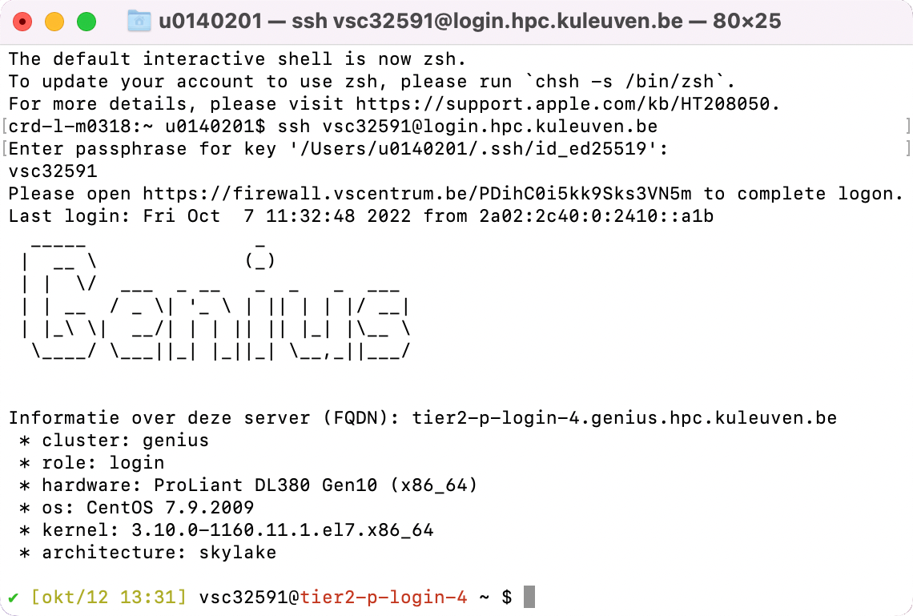
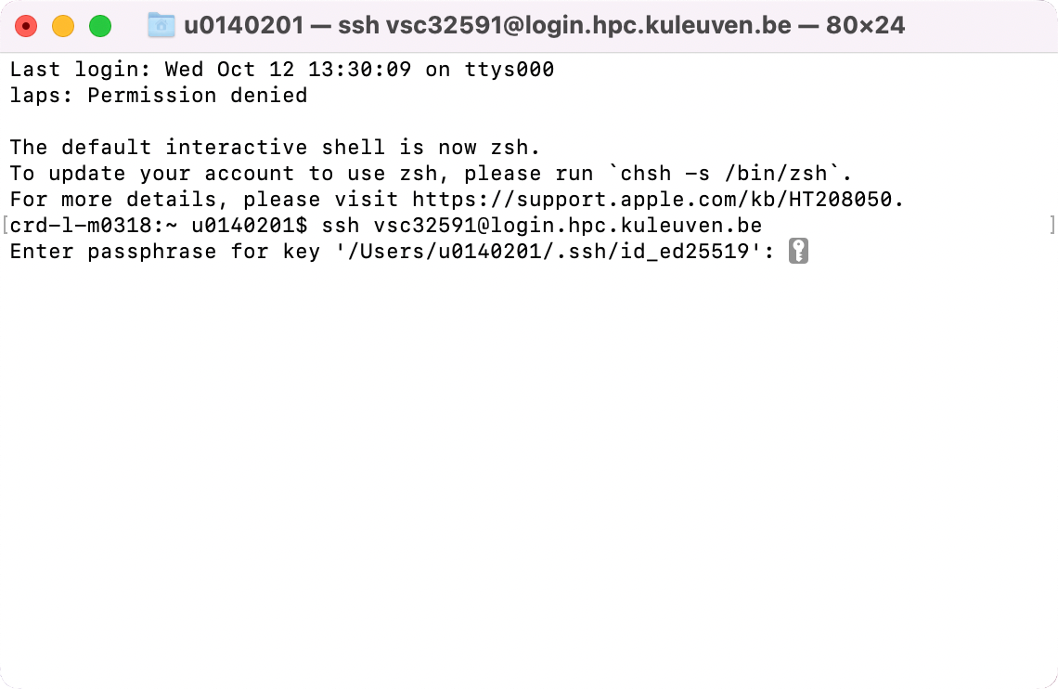
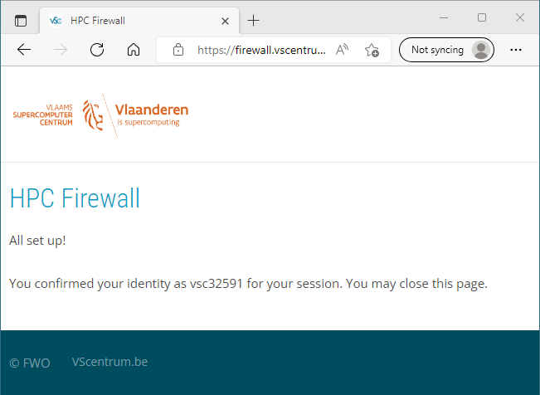
Connecting via Terminal
Host Name: login.hpc.kuleuven.be
(Linux and Mac)
Use ssh to connect: $ ssh vscXXXXX@<host_name>
If key not found: $ ssh -i </path/to/keyfile> ...
If asked for password, please stop connecting and contact support, otherwise after a few attempts you will be blocked for 24h.

Slide 46
Connecting via Terminal
Host Name: login.hpc.kuleuven.be
(Linux and Mac)
With SSH Agent
Check your SSH Agent. Is your SSH key found? $ ssh-add –l
If your SSH Agent is not running: eval $(ssh-agent)
If your key is not found, add it to the Agent: $ ssh-add </path/to/keyfile>
Use ssh to connect: $ ssh vscXXXXX@<hostname>

Slide 47
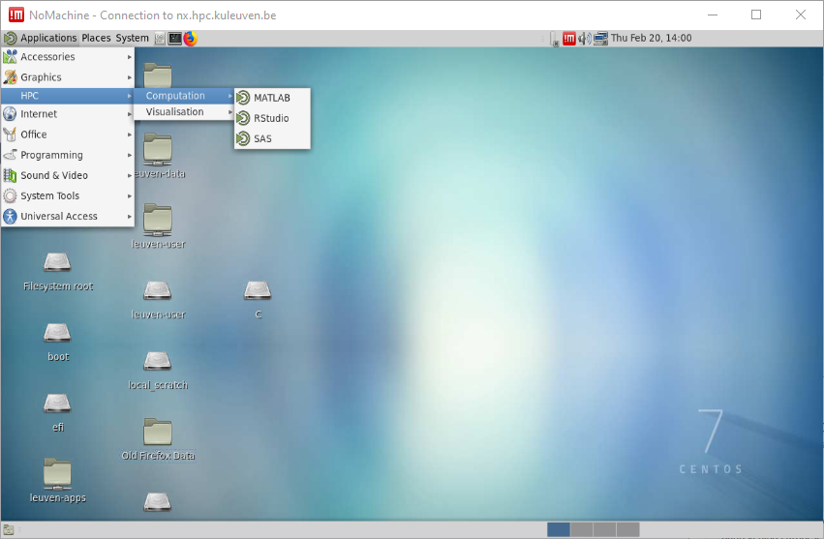
NX
NX is a graphical login node
A new session stays active for long
Rich suite of applications; e.g. Terminal, Firefox, text editor, Matlab, SAS etc.
NX is a shared, login-node. Please do not compute on NX.
NX server is attached to Genius. Jobs sent from NX enter Genius queue
Client: NoMachine Configuration Guide
Using OpenSSH key Convert your key
47

Slide 48
File Transfer with FileZilla

Slide 49




File transfer
Local Files
VSC Account
Application | OS
FileZilla | Windows, Linux, Mac
WinSCP | Windows
rsync, scp | Linux, Mac
Globus | Window, Linux, Mac
49

Slide 50
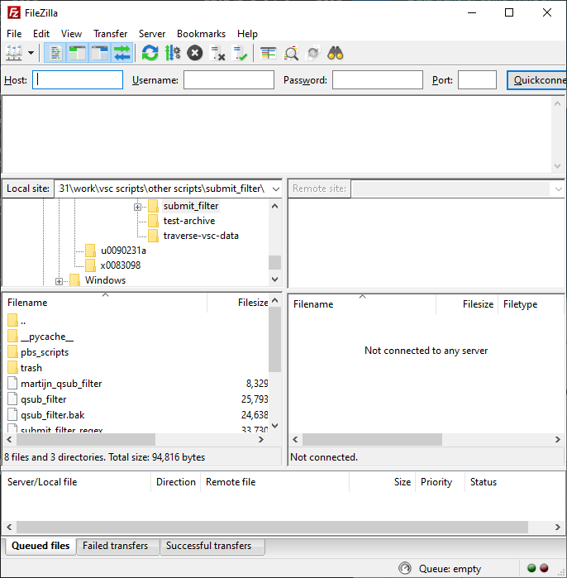
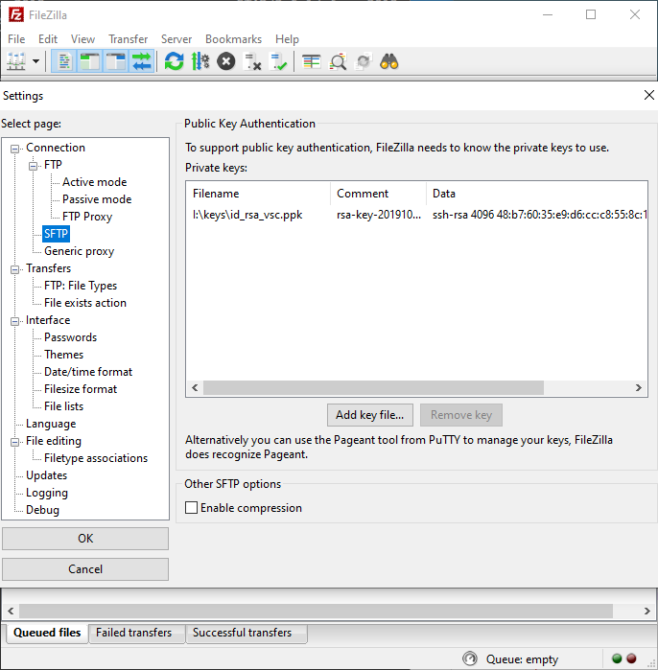
File transfer
1
Edit -> Settings
2
4
3
50

Slide 51
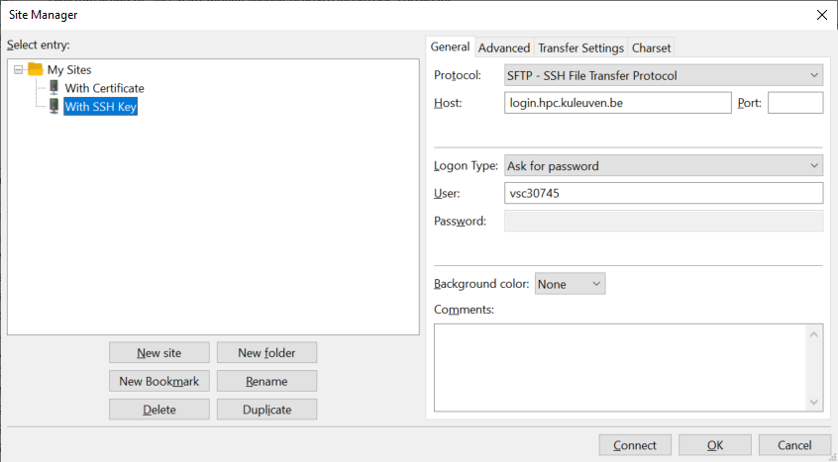
File transfer
6
7
8
5
9
51

Slide 52
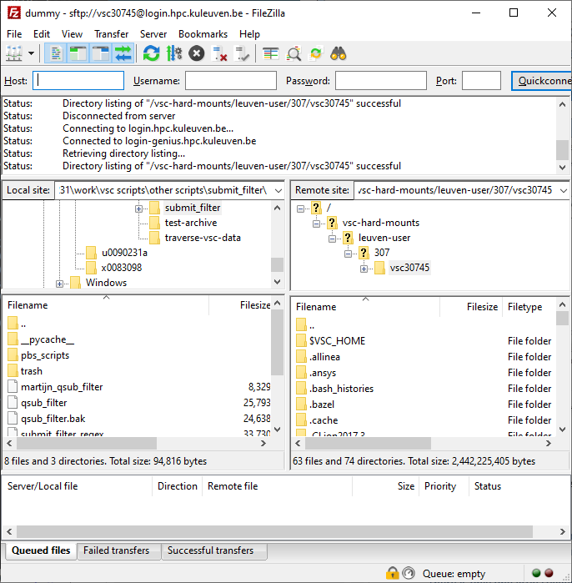
For convenience, you’d better bookmark your data and scratch folders!
Instead, go to your $VSC_DATA folder, e.g. /data/leuven/399/vsc39934
Your local machine (e.g. laptop)
Your VSC storage (e.g. $VSC_DATA, $VSC_SCRATCH). Note: by default you arrive at your own $VSC_HOME. Copy nothing there!
52

Slide 53
rsync
For Linux, Mac and Windows WSL users
Synchronize source and destination
Requires SSH key
Listens to your SSH agent
Syntax $ rsync –av /path/to/source vsc3XXXX@login.hpc.kuleuven.be:/path/to/destination
53

Slide 54

Globus
Transfer, share and search within data
Schedule and resume (large) transfers
Fully supported by all VSC sites (available on Tier-2 and Tier-1)
Web-interface
Workflow: Define “endpoint” on the source Define “endpoint” on the destination Transfer between endpoints
Existing endpoints: Tier-2: home/data/scratch storages Tier-1: data/scratch
54

Slide 55

55

Slide 56
Open Ondemand

Slide 57

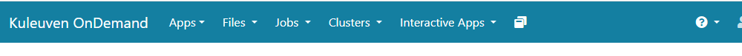
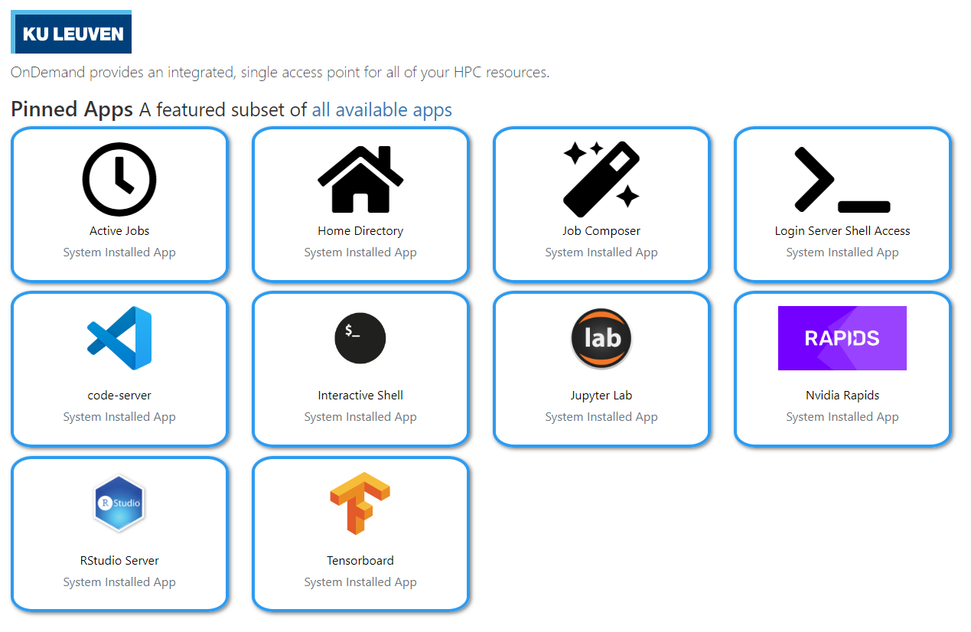
Open OnDemand
Access clusters via web browser
https://ondemand.hpc.kuleuven.be
Login via KULeuven MFA
File browser
Interactive apps + integrated shell
Create, start and monitor jobs
Develop, compile and test your code
VSCode editor
JupyterLab, Rstudio, MATLAB, ParaView and Tensorboard
57

Slide 58

Open OnDemand
Access your VSC storage
Use “Files” menu to access your VSC_HOME and VSC_DATA
VSC_SCRATCH is not available
File/Folder Management
OK to transfer small files/folders
Open any (sub)folder in terminal (new window)
Deleted files/folders could be retrieved from (hourly, daily, weekly) snapshots
58

Slide 59
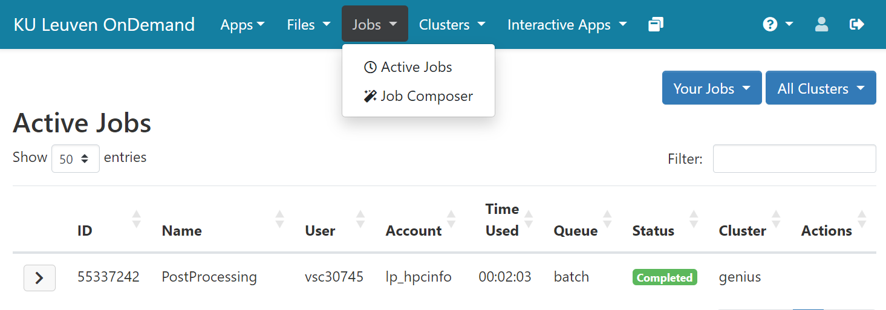
Open OnDemand
Monitor/manage all your jobs
59

Slide 60
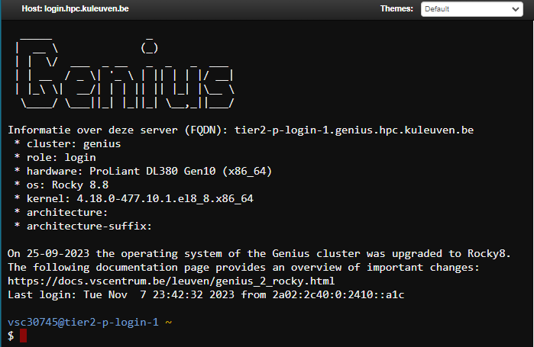
Open OnDemand: Login Server Shell Access
Login Shell
Start shell in a new browser tab
You land on Genius Accessing wICE goes via Genius login
You land on your VSC_HOME cd to data/scratch/staging immediately
Do NOT compute on the login nodes
Try: $ sam-balance $ myquota
60

Slide 61
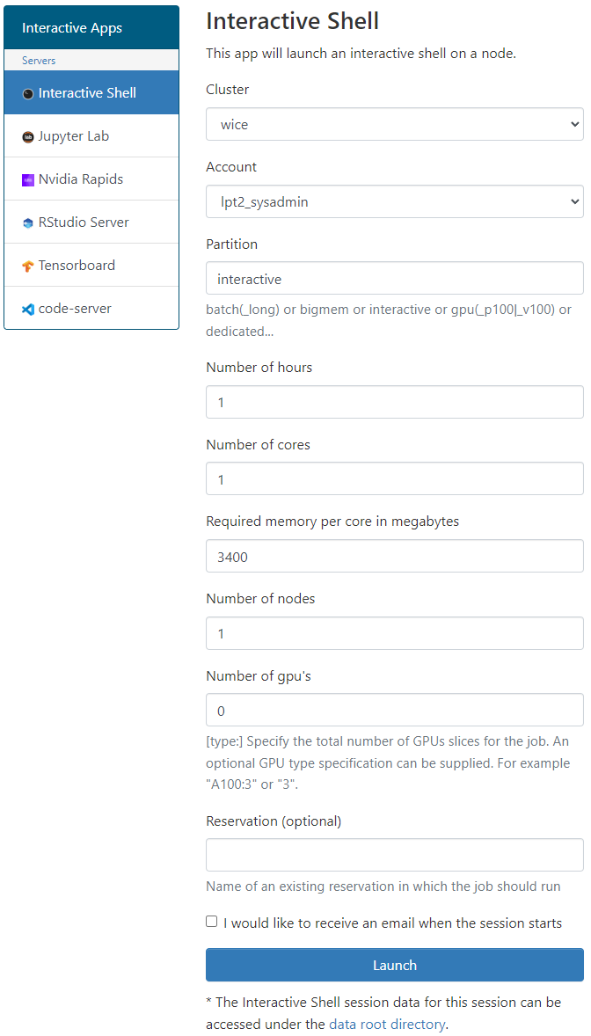
Open OnDemand: Interactive Shell
Interactive Shell
Start shell as a job (on a compute node)
Recommended to: Install your own software (in VSC_DATA) Test/run your program interactively Debug a program
Choose the relevant cluster, partition and resources (core, memory, GPU)
61

Slide 62
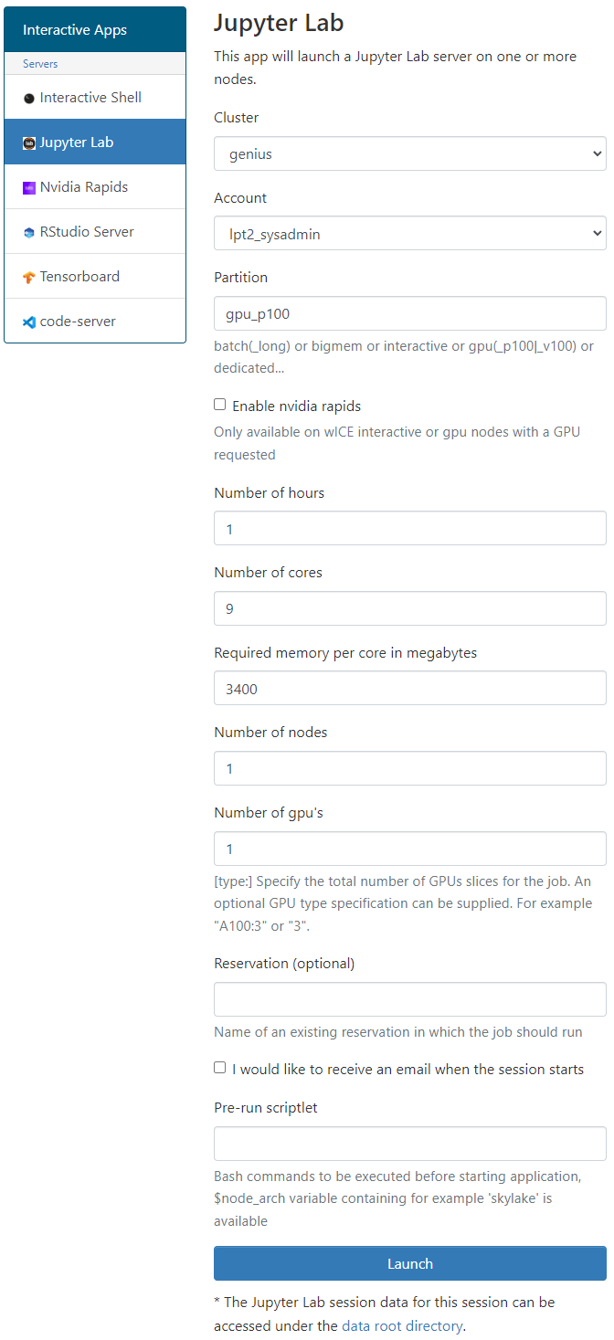
Open OnDemand: Jupyter Lab
Jupyter Lab
Create a notebook as a job (on a compute node)
Best practice to: pre/post-processing your data prototyping add figures and text for pedagogical purposes
Choose the relevant cluster, partition and resources (core, memory, GPU)
Extensions are not supported (for now)
User your own Python/R kernels (next slide)
62

Slide 63
Open OnDemand: Custom R/Python Kernels
My Kernels
Default R/Python kernels are old and limited
You can create a miniconda env and add it to your OnDemand kernels
Step 1: Miniconda
Start an Interactive shell
Go to your data folder $ cd ${VSC_DATA}
Download miniconda $ wget https://repo.continuum.io/miniconda/Miniconda3-latest-Linux-x86_64.sh
Install miniconda into your data folder $ bash Miniconda3-latest-Linux-x86_64.sh –p $VSC_DATA/miniconda3
Permanenly add the path to miniconda to your ~/.bashrc $ echo 'export PATH="${VSC_DATA}/miniconda3/bin:${PATH}" ' >> ~/.bashrc
63

Slide 64
Open OnDemand: Custom R/Python Kernels
Step 2: New Environment
Create a new environment <env_name> with all packages you need, e.g. $ conda create -–name=<env_name> numpy scipy … Enable your new environment $ source activate <env_name> Add the ipykernel package $ conda install –c conda-forge ipykernel
Step 3: Register Your Kernel
$ python –m ipykernel install –prefix=~/.local --name <env_name>
Start a new Jupyter Lab session, and the new kernels must be there
64

Slide 65

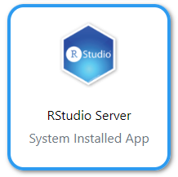

Open OnDemand: Other tools
Start Visual Studio Code server as a job.
Develop, deploy and debug your workflow directly on HPC.
Using interactive partition on wICE is free of charge, and is relevant here.
Supports many languages + Github integration.
Start R IDE as a job.
Install your own packages in $VSC_DATA.
Track machine learning metrics and visualize data during the workflow.
You need to provide a log folder.
65

Slide 66
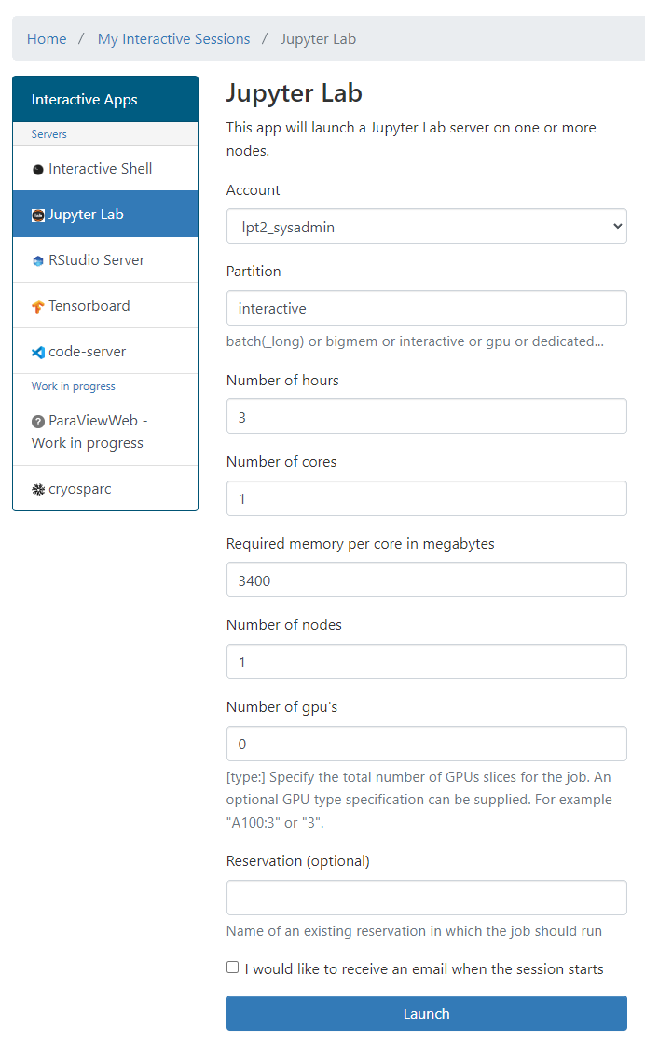
Open OnDemand: Resources
E.g. to start a Jupyter Notebook
Pick a valid Slurm credit account
Default partition: batch interactive: Max 8 cores, 1 GPU (shard), 16 hr
Default resources: 1 core, 1 hour, 3400MB RAM, no GPU
(At the moment) you cannot use scratch and staging
lp_myproject
66

Slide 67
Software Stack

Slide 68
Software: Available Modules
OS: Rocky Linux 8.x
Toolchains:
Intel (icc, icpc, ifort; Intel MPI; Intel MKL)
FOSS (gcc, g++, gfortran; OpenMPI; ScaLAPACK, OpenBLAS, FFTW)
Toolchain year on Genius from 2018a; on wICE from 2021a
Note: Never mix FOSS and Intel compilers (gives dependency conflict)
Command | Remark
module av | List all available modules
module av Python | List all Python-related modules
module spider Python | Get more info
module load Python/3.6.4-intel-2018a | Load a specific module
module list | List all loaded modules and their dependencies
module unload Python/3.6.4-intel-2018a | Unload a module (but dependencies still stay)
module purge | Remove all modules from your work session

Slide 69
Software: Your Specific Needs
You can always install your desired software in your $VSC_DATA Use Intel or FOSS toolchains
Compile your code on a compute node (with interactive job)
If you cannot, ask us for help
Specific Python/R packages is managed by users via conda
Read more about Python Package Management
Read more about R Package Management

Slide 70
Starting to Compute

Slide 71







Resource Glossary
Cluster: Which machine to use? Genius or wICE?
Nodes: how many compute servers to request?
Cores: how many cores per node to use?
Memory requirement: how much memory each core needs?
Partition: gpu, bigmem, superdome, amd
Walltime: how long to use resources?
Storage: how much storage (data, scratch, etc) the job needs?
Credits: how many compute credits will be consumed?

Slide 72
Default Resources
Cluster: the local machine you are logged into (Genius or wICE)
Nodes: 1
Cores: 1
RAM: depends on which node(s) you use
Partition: batch
Walltime: 1 hour
Storage: no default
Credits: no default

Slide 73
Serial Application (1 process on 1 core)
Single Process
One node
Multi-Core Appl. (N threads on N cores from 1 node)
Thread Group
Process Group
Distributed Appl. (many processes on
multiple cores/nodes)

Slide 74
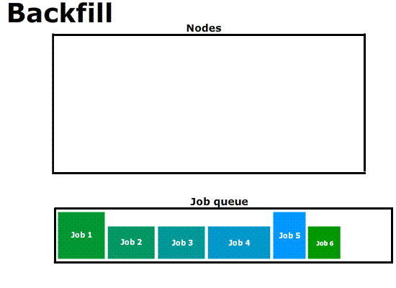
cores
time

Slide 75



Interactive Job
Compute nodes
Login node
srun …
Batch Job
Compute nodes
Login node
sbatch script.slurm

Slide 76
Interactive Job on wICE
Request interactive job
Project Name for Compute Credits
For special hardware or queue
Target cluster
$ srun --account=<project name> --partition=interactive –-clusters=wice \ --nodes=1 --ntasks=4 --time=01:00:00 --pty bash -l
-
-
Number of nodes
Number of processes or cores
Max. Runtime
Interpret with Bash
Remark
Specifying <project name> for credits is mandatory, e.g.: –A lp_hpcinfo
Implicit defaults for an interactive job on wICE are: -n 1, -t 01:00:00, --mem-per-cpu=2000M

Slide 77
Command | Purpose
$ sbatch ... | Submit a batch job
$ srun ... | Submit an interactive job
$ scancel --cluster=wice <JobID> | Cancel a specific pending or running job
$ scontrol show job --clusters=wice <JobID> $ slurm_jobinfo <JobID> | Detailed job info (very useful to diagnose issues)
$ squeue --clusters=wice --long | Status of all recent jobs
$ squeue --clusters=wice --start | Give a rough estimate of start time
$ sinfo --clusters=wice | Info about the state of available partitions and nodes
$ sacct --clusters=wice --batch --job <JobID> | Show minimal info about a queue or partition (-p)
$ slurmtop $ scontrol --clusters=wice show node <hostname> | Overview of the cluster Get detailed information about the status of a node
$ sam-balance | Overview of all your available credit projects
$ sam-list-allocations | Detailed overview of your credit allocation history

Slide 78
Jobs: Slurm submit options
SLURM | Remarks
--nodes=X --ntasks-per-node=Y --ntasks=X*Y --ntasks=X --cpus-per-task=Y | or or (e.g. Hybrid MPI + OpenMP)
--partition=<partition_name> | Default: "batch" partition
--mem-per-cpu=<size><M> | Min memory per core, e.g. 5000M for Genius
--time=<dd-hh:mm:ss> | e.g. 1-12:30:00
--job-name=<job_name>
--output=<file_template> | STDOUT; defaullt=“slurm-%j.out”
--error=<file_template> | Default: redirect to STDOUT
--mail-type=FAIL,BEGIN,END
--mail-user=<email-address>
--export=<ALL,key=value> | Additional variables to pass to job
--account=<account_name> | Mandatory (credits)
78

Slide 79
Argument Shorthands
Shorthand | Full Argument | Meaning
-A | --account | Slurm account name
-a | --array | Job array range
-M | --clusters | Machine or cluster name
-c | --cpus-per-task | Num cores per task (default=1)
-d | --dependency | Job dependency (after, afterok, afterany, …)
-I | --input | STDIN filename
-e | --error | STDERR filename
-o | --output | STDOUT filename
-t | --time | Maximum walltime
-N | --nodes | Minimum num nodes
-n | --ntasks | Maximum num tasks
-p | --partition | Partition name
Some (not all) of the sbatch, srun and salloc command line arguments have shorthands

Slide 80
Interactive Jobs
Interactive job: 1 core for 1 hour (default) $ srun --clusters=wice --account=lp_hpcinfo --pty /bin/bash -l
Interactive job with X-forwarding $ srun --clusters=wice --account=lp_hpcinfo –x11 --pty /bin/bash -l
Request fraction of a node from interactive partition $ srun --clusters=wice --account=lp_hpcinfo --nodes=1 --ntasks=4 \ --partition=interactive --pty /bin/bash –l
Request a GPU accelerator $ srun --clusters=wice --account=lp_hpcinfo --nodes=1 --ntasks=18 \ --partition=gpu --gpus-per-node=1 --pty /bin/bash -l
To join a running job $ sattach <JobID>.<StepID> # e.g. 55439251.0

Slide 81
Example Slurm Job Script
jobscript.slurm
#!/bin/bash –l
#SBATCH --clusters=wice #SBATCH --account=lp_hpcinfo #SBATCH --nodes=1 #SBATCH --ntasks=4 #SBATCH --mem-per-cpu=3400M #SBATCH --job-name=hpc_workflow #SBATCH --mail-type=BEGIN,END,FAIL #SBATCH --mail-user=my.name@kuleuven.be
module load intel/2021a module load Python/3.9.5-GCCcore-10.3.0
which python3
cd $VSC_SCRATCH/projects/simulations
cp –r $VSC_DATA/input_data .
python modelling.py
cp –r output_data $VSC_DATA
rm –rf ./input_data ./output_data
Shebang
Resource List
Module load(s)
Move data
Execute commands
Move data
81

Slide 82
Job Script
Batch Workload
#!/bin/bash -l
…
Submit the job to the batch server
Receive a unique JobID
Error and output files
Command Line
$ sbatch simulation.slurm
JobID
Submitted batch job 60042478 on cluster wice
stderr, stdout
$ ls *.out slurm-60042478.out

Slide 83
Output File
STDOUT + STDERR
STDERR and STDOUT are by default redirected to a single file:
slurm-<JobID>.out
Contains job info, all errors and warnings, and printouts
Always study it
Address all warnings and errors (if you can)
Typical error examples …
$ ls slurm-*.out slurm-60042478.out
Out of Memory
slurmstepd: error: Detected 1 oom-kill event(s). Some of your processes may have been killed by the cgroup out-of-memory handler.
Short Walltime
slurmstepd: error: *** JOB 60042478 ON s28c11n2 CANCELLED AT 2023-02-08T10:03:43 DUE TO TIME LIMIT ***
Low Disk Space
IOError: [Errno 122] Disk quota exceeded

Slide 84
Output File
Output File
SLURM_JOB_ID: 60033947
SLURM_JOB_USER: vscXXXXX
SLURM_JOB_ACCOUNT: lp_wice_pilot
SLURM_JOB_NAME: testjob
SLURM_CLUSTER_NAME: wice
SLURM_JOB_PARTITION: batch
SLURM_NNODES: 1
SLURM_NODELIST: m28c30n4
SLURM_JOB_CPUS_PER_NODE: 72
Date: Tue Jan 10 17:02:04 CET 2023
Walltime: 00-01:00:00
==================================
/apps/leuven/rocky8/icelake/2021a/softwar
e/intel-compilers/2021.2.0/compile
r/2021.2.0/linux/bin/intel64/icc
cp: cannot stat '/apps/leuven/trai
ning/test': No such file ordirecto
ry
Hello World
Always created
slurm-<job_id>.out
Contains all standard output and error (instead of screen)
Always study it
Standard Output and Error channels can be redirected to other files: #SBATCH --output … #SBATCH --error …
Resource Summary
Stdout
stdout
$ ls slurm-*.out slurm-60041238.out

Slide 85
Output File
Example
$ scontrol show job --clusters=wice 60049330
JobId=60049330 JobName=f70.slurm
UserId=vsc3…(253…) GroupId=vsc3…(253…) Account=lp_my_project QOS=lp_my_project
JobState=PENDING Reason=QOSGrpBillingMinutes SubmitTime=2023-02-16T00:24:58 EligibleTime=2023-02-16T00:24:58 Partition=batch NodeList= NumNodes=4-4 NumCPUs=288 NumTasks=288 CPUs/Task=1
TRES=cpu=288,mem=979200M,node=4,billing=733 MinCPUsNode=72 MinMemoryCPU=3400M WorkDir=/vsc-hard-mounts/leuven-data/3../vsc3…/Odonate_SOM
StdErr=/vsc-hard-mounts/leuven-data/3../vsc3…/Odonate_SOM/slurm-60049330.out
StdIn=/dev/null
StdOut=/vsc-hard-mounts/leuven-data/3../vsc3…/Odonate_SOM/slurm-60049330.out
Diagnosis
Why is my job in pending/hold state? Check out the “Reason” on Slurm docs: https://slurm.schedmd.com/resource_limits.html

Slide 86
Other Partitions on wICE
GPU
Big Memory
#SBATCH --partition=gpu #SBATCH --nodes=1 #SBATCH --ntasks=18 #SBATCH --gpus-per-node=1
#SBATCH --partition=bigmem #SBATCH --nodes=1 #SBATCH --tasks-per-node=72 #SBATCH --mem-per-cpu=28000M

Slide 87
Interactive Partitions
Accessible via command line and Open OnDemand
To quickly compile, test, debug your (parallel) application
To pre-/post-process your data and make visualizations
Short queue time
12 nodes on Genius: 36 cores/node, 192 GB mem
4 nodes on wICE: 64 cores/node, 512 GB mem, 1 GPU (=7 GPU instances)
Max resource per user: 8 cores, 1 GPU instance, 16 hour walltime
Free of charge
Interactive Job
$ srun --account=lp_myproject --clusters=wice \
--partition=interactive --nodes=1 --time=16:00:00 \
--gpus-per-node=1 --pty bash -l

Slide 88
Debugging Partitions
Accessible via command line and Open OnDemand
Quickly test if your (parallel) application works
Short queue time
Only one job at a time, max walltime: 1 hr
Cluster | Partition | Resources
Genius | batch_debug | 2x Cascadelake
 | gpu_p100_debug | 1x Skylake node (4x P100 GPUs)
wICE | interactive | 4x Icelake (1x A100 GPU)
 | gpu_a100_debug | 1x Icelake (4x A100 GPUs)

Slide 89
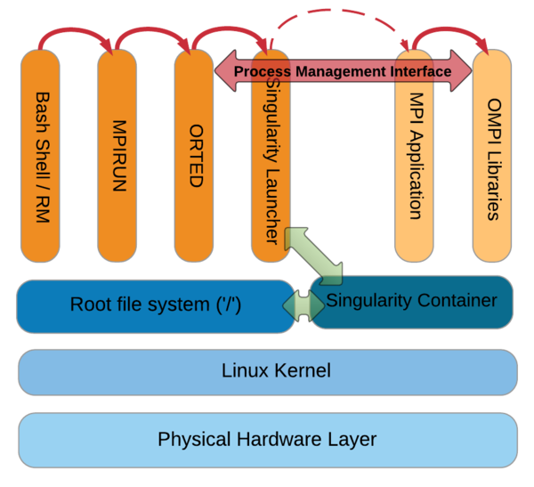
Apptainer (Singularity) Containers
What?
Self-contained OS & software & data
Why?
fully resolved dependency chains
portable workflow
How?
You create the image
Run it on Genius/wICE
MPI/OpenMP is supported
#!/bin/bash -l
#SBATCH --time=30:00 #SBATCH --nodes=2 #SBATCH --ntasks=72 #SBATCH --clusters=wice #SBATCH --account=lp_hpcinfo
apptainer run Project.simg ./model.exe
script.slurm

Slide 90
Worker Framework

Slide 91
Sequential…
A shell program consists of a sequential list of commands -> bash script on HPC cluster will run sequentially
Socket 0
Socket 1
#!/bin/bash
My_program 1
My_program 2
My_program 3
…
…
My_program 20
L3
L3
DDR
0
5
10
15
DDR
DDR
1
6
QPI
11
16
DDR
2
L1
L2
QPI
17
core0
7
12
DDR
DDR
3
8
13
18
DDR
4
9
14
19
DDR
IB
I/O
91

Slide 92
Sequential…
A shell program consists of a sequential list of commands -> bash script on HPC cluster will run sequentially
Socket 0
Socket 1
#!/bin/bash
My_program 1
My_program 2
My_program 3
…
…
My_program 20
L3
L3
DDR
0
5
10
15
DDR
DDR
1
6
QPI
11
16
DDR
2
L1
L2
QPI
17
core0
7
12
DDR
DDR
3
8
13
18
DDR
4
9
14
19
DDR
IB
I/O
Use worker on the cluster
92

Slide 93
Parallel Computing
Talk to us about worker framework
Lucky you!
Serial:
one program, on one core
“Embarrassingly parallel” problems:
lots of runs of one program, with different parameters
Problems that require “real” parallel algorithms
OpenMP
MPI : Message Passing Interface

Slide 94
Use case: parameter exploration
temperature | pressure | humidity
293.0 | 1.0e05 | 87
… | … | …
313.0 | 1.3e05 | 75
#!/bin/bash –l
#SBATCH --cluster=wice
#SBATCH --nodes=1
#SBATCH --ntasks-per-node=1 #SBATCH --time=10:00
#SBATCH --account=lp_myproject
cd $SLURM_SUBMIT_DIR weather –p 1.0e05 –t 293.0 –h 87
job_001.slurm
#!/bin/bash –l
#SBATCH --cluster=wice
#SBATCH --nodes=1
#SBATCH --ntasks-per-node=1 #SBATCH --time=10:00
#SBATCH --account=lp_myproject
cd $SLURM_SUBMIT_DIR weather –p 1.0e05 –t 293.0 –h 87
job_030.slurm
Many single core computations
#!/bin/bash –l
#SBATCH --cluster=wice
#SBATCH --nodes=1
#SBATCH --ntasks-per-node=1 #SBATCH --time=10:00
#SBATCH --account=lp_myproject
cd $SLURM_SUBMIT_DIR weather –p 1.0e05 –t 293.0 –h 87
job_600.slurm
…
…
94

Slide 95
Solution: worker with -data
temperature | pressure | humidity
293.0 | 1.0e05 | 87
… | … | …
313.0 | 1.3e05 | 75
data.csv
#!/bin/bash –l
#SBATCH --cluster=wice
#SBATCH --nodes=2
#SBATCH --ntasks-per-node=72 #SBATCH --time=01:00:00
#SBATCH --account=lp_hpcinfo
cd $SLURM_SUBMIT_DIR weather -p $pressure –t $temperature –h $humidity
job.slurm
# From Genius login node: $ module load worker/1.6.12-foss-2021a $ wsub –data data.csv –batch job.slurm
95

Slide 96
Solution: worker with -data
temperature | pressure | humidity
293.0 | 1.0e05 | 87
… | … | …
313.0 | 1.3e05 | 75
data.csv
#!/bin/bash –l
#SBATCH --cluster=wice
#SBATCH --nodes=2
#SBATCH --ntasks-per-node=72 #SBATCH --time=01:00:00
#SBATCH --account=lp_hpcinfo
cd $SLURM_SUBMIT_DIR weather -p $pressure –t $temperature –h $humidity
job.slurm
# From wICE interactive session: $ srun --clusters=wice --account=lpt2_sysadmin --partition=interactive --pty bash –l $ module load worker/1.6.12-foss-2021a $ wsub –data data.csv –batch job.slurm
96

Slide 97

Data exploration: steps
Write slurm script with parameters
Create Excel sheet with data
Convert to CSV format
Submit with wsub
walltime is time to complete all work items
$${walltime}_{job}≥\frac{N∙{walltime}_{work item}}{nodes∙ntasks\text{−}per\text{−}node}$$

Slide 98






Worker processing: informally
slave₁
slave queries for work
/
master sends work
/
slave notifies on success/failure, queries
for more work
master
…
Done!
master sends stop
/
slave_{S}
batch.sh.worker

Slide 99


How to use worker well?
Many work items, i.e., #work items/#proc >> 1
time(work item) > 1 minute
Work item is not multithreaded
Work item is multithreaded
will work, but user must be careful to request the right resources
Use –threaded <n> flag with wsub
Here be dragons: licensing!
Here be Dragons

Slide 100
Worker & multithreading
Some software uses multithreading automatically, e.g.,
R
Matlab
Will use as many threads as there are cores, regardless of system load
36 cores/node
36 work items/node
72 × 72 threads/node
Oversubscription: very inefficient!!!

Slide 101
Controlling number of threads
#!/bin/bash -l
#SBATCH –account=lp_myproject
#SBATCH --cluster=wice
#SBATCH --time=1:00:00
#SBATCH --nodes=2
#SBATCH --ntasks-per-node=72
module load R
cd $SLURM_SUBMIT_DIR
export OMP_NUM_THREADS=1
Rscript program $a $b
program_pe.slurm
R, most of the time: OMP_NUM_THREADS=1
Matlab
Use maxNumCompThreads(1) function call
Use compiler flag: mcc –singleCompThread …
101

Slide 102

Help on worker
See documentation http://worker.readthedocs.io/
Each command has help, use –h
All resources have to be specified inside slurm script
wresume does not work yet. Only wsub is so far supported
-master flag does not work yet

Slide 103
Submitting worker jobs
Let us use one of the worker examples: https://github.com/gjbex/worker/tree/development_slurm/examples/bash_example
#!/bin/bash –l #SBATCH --nodes=1 #SBATCH --ntasks-per-node=27 #SBATCH --time=00:30:00 #SBATCH --account=lpt2_sysadmin #SBATCH --clusters=wice cd $SLURM_SUBMIT_DIR alphabet.sh $letter $counter
alp.slurm
letter,counter
a,1
b,2
c,3
d,4
e,5
f,6
....
alpha.csv

Slide 104
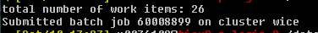
Submitting worker jobs
From Genius
#!/bin/bash -l
module purge
module use /apps/leuven/rocky8/skylake/2021a/modules/all
module load worker/1.6.12-foss-2021a-wice
wsub -batch alp.slurm -data alpha.csv

Slide 105
Submitting worker jobs
From interactive job on wICE
#!/bin/bash -l
module --force purge
module use /apps/leuven/rocky8/icelake/2021a/modules/all
module load worker/1.6.12-foss-2021a
wsub -batch alp.slurm -data alpha.csv

Slide 106
Demo: Test yourself

Slide 107
Demo/test yourself
Request membership to lp_hpcinfo group (account.vscentrum.be)
File transfer with Filezilla
Login with NX
Check disk quota
Check the credits
Check/load/list/unload/purge module

Slide 108
Demo/test yourself
Copy training material /apps/leuven/training/HPC_intro/ to your $VSC_DATA
Submit cpujob to the cluster
List all your jobs squeue -M wice
Check the information about the cpujob slurm_jobinfo -M wice <job_ID>
Modify the mpi.slurm script to request 1 node, 72 cores for 30 minutes and get the notification about job start/end by e-mail
Check the status of all the jobs

Slide 109
Demo - monitoring
Submit an interactive job
Run your program on a compute node
Open a new terminal and ssh to a compute node
Check the resources usage (htop)
Submit a batch GPU job
While the job is running get the information about the node slurm_jobinfo...
and check usage of resources on the node ssh, top, nvidia-smi

Slide 110
Demo - worker
Copy intro training files (/apps/leuven/training/worker/) to your $VSC_DATA
Go to exercise1 directory
Submit worker job
Check the output file

Slide 111
Questions
Helpdesk: hpcinfo@kuleuven.be or https://admin.kuleuven.be/icts/HPCinfo_form/HPC-info-formulier
VSC web site: http://www.vscentrum.be/
VSC documentation: https://docs.vscentrum.be/en/latest/
VSC agenda, training sessions, events: https://www.vscentrum.be/vsctraining
Systems status page: http://status.vscentrum.be

